Slide 1

Forecasting Ebola in North Eastern DRC
James Munday & Sebastian Funk

Slide 2




Our Team
Sebastian Funk
James Munday
Joel Hellewell
Flavio Finger
Wellcome Trust funded
To develop methodology for forecasting of outbreaks and their evaluation

Slide 3
Forecasting Ebola in North Eastern DRC
Why and what we are forecasting
The model
Results
Forecast evaluation
Advancing forecasting

Slide 4

Why are we forecasting
Challenge:
Vaccine candidates ready for phase 3 trials (including J&J prime boost)
To measure efficacy of vaccine, second trial needs to be based in region with no previous vaccination.
Current vaccine distributed reactively – administered to contacts of cases
Cases of Ebola must be present
Objective:
Forecast risk of Ebola cases in each health zone in the region of the outbreak with particular focus on those where cases have not yet been reported.

Slide 5
The model
Inputs
N_{it} | Cases | HDX (Sit Reps)
d_{ij} | Distance | Euclidian distance between centroids
P_{i} | Population | Aggregates from LandScan estimates
Parameters
γ | Internal coeff. | fitted
α | Spatial coeff. | fitted
k | Distance exponent | fitted
Constants
D | Duration of infection | Fixed at 5 days
L | Latent period | Fixed at 7 days
Static model of spatial risk:
Local transmission
Spatial interaction
Gravity model

Slide 6
The model
Fit the model using HMC to previous 50 days of outbreak
Static model of spatial risk:
Local transmission
Spatial interaction
Project cases using joint posterior distribution
Gravity model
Resolve to a risk of binary outcome: cases/no cases
Evaluate forecasts
Null model: Health Zones with cases in the previous 28 days

Slide 7
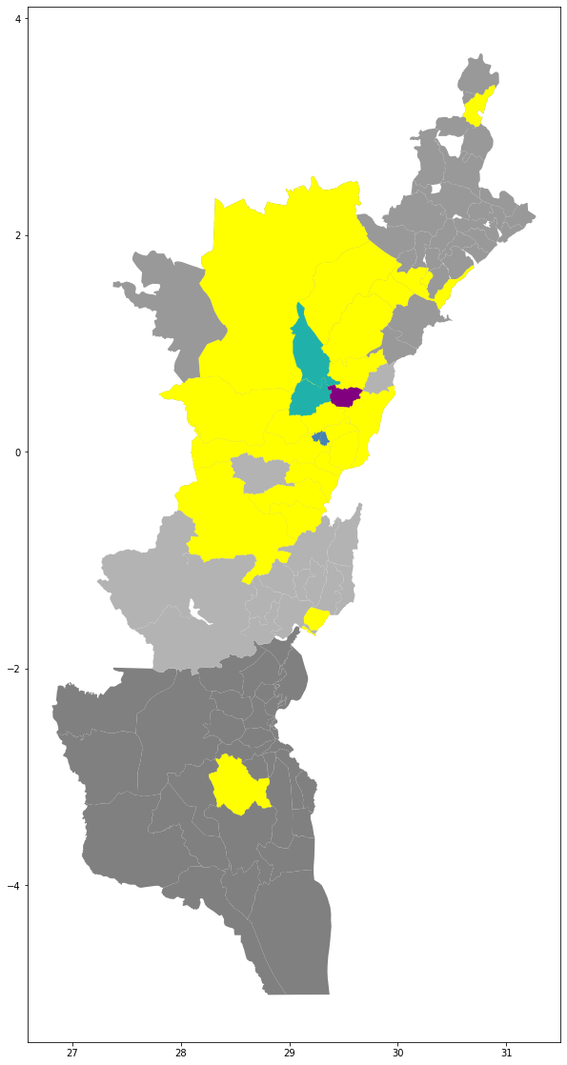
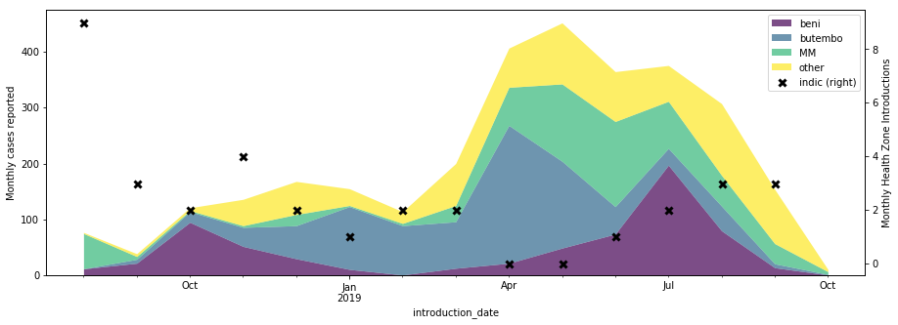
The outbreak

Slide 8
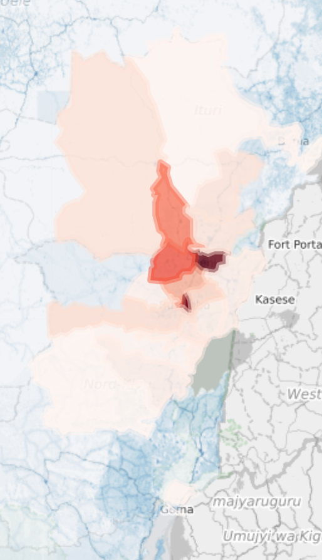
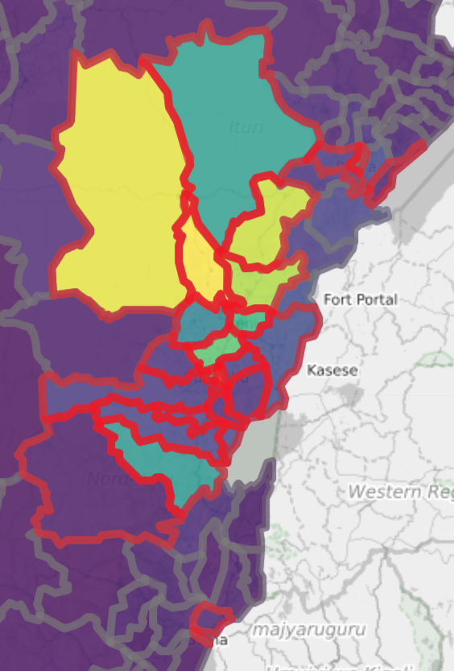
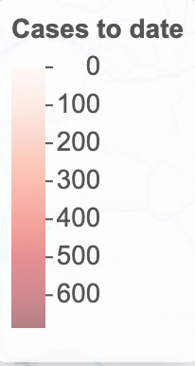
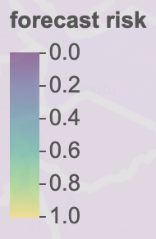
Results – forecasts

Slide 9
Results – forecasts
https://epiforecasts.io/ebola-drc/

Slide 10
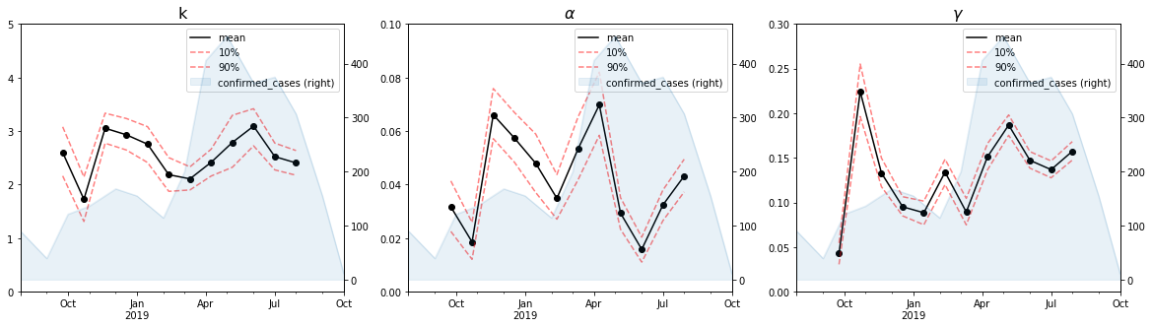
Results – model parameters
Variation in posterior distribution of parameters over time
Different localities involved?
Interventions
Other factors
Important to re-fit the model regularly

Slide 11
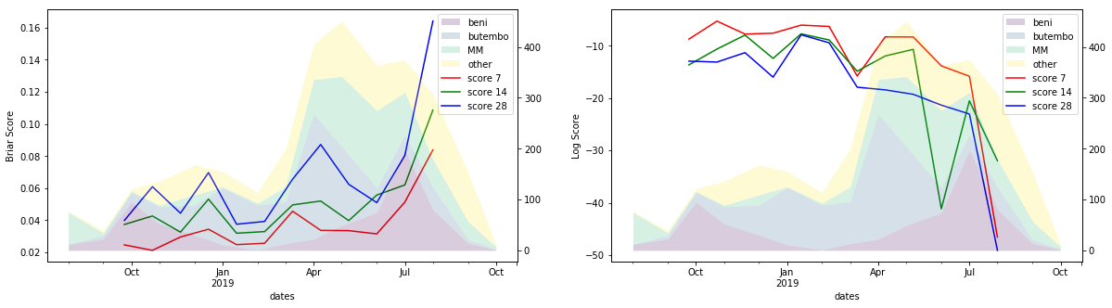
Forecast evaluation – proper scoring
The sum over N events of the square of the difference between the probability of observing an event and the observation o_{i} status (1 or 0)
The sum over N events of the log probability of observing or not observing events that have or have not occurred

Slide 12
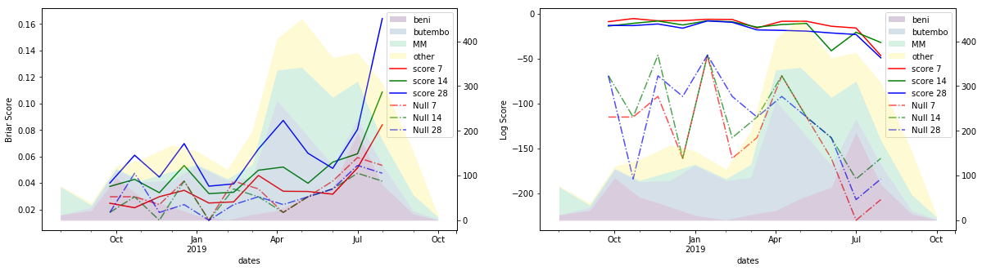
Forecast evaluation – proper scoring
Comparing the forecast to the null model
Null model: Health Zones with cases in the previous 28 days

Slide 13
Advancing forecasting – real world evaluation
Does forecast evaluation tell us what we really need to know?
Expert elicitation – with and without the forecast
Quantifying risk effectively
Understanding what kind of information is most useful when

Slide 14
Summary
Our model provides risk of Ebola cases in DRC at a health zone level (https://epiforecasts.io/ebola-drc/)
Parameter values and forecast performance varies over the course of the outbreak – particularly in recent months
Variation in performance may be due to different settings and impact of interventions
Providing useful forecasts in the future will require holistic evaluation – not just quantitative

Slide 15
Thank you
Especially to:
Sebastian Funk
Flavio Finger
Joel Hellewell
Anton Carmacho
John Edmunds
Alicia Rosello
Thibaut Jombart

